Slide 1

Preliminary Presentation on Project on
“SMART WHEELCHAIR FOR PARALYZED”
Presented by
24. JASIRA T P
34. NAYANA RAMESHAN
46. SHRAVAN SREEDEEP
48. SOORYA P
under the guidance of
Dr. C SREEKUMAR
DEPARTMENT OF ELECTRICAL & ELECTRONICS ENGINEERING
GOVT. COLLEGE OF ENGINEERING KANNUR- 670563
April 2022

Slide 2
OVERVIEW
Introduction
Objectives
Literature Review
Wheelchair Design
Calculation of Rolling Resistance
Calculation of Power
Work done In This Semester
Work Plan
Conclusion
Reference

Slide 3
INTRODUCTION
Paralyzed stroke patients are unable to normally communicate with their environment.
Part of their body that is under their control is their eyeballs.
Basic day to day operations are switching on basic devices like fan, bulb etc.
Smart Wheel Chair is the solution that we are proposing for these problems.

Slide 4
OBJECTIVES
To track eye movement and control basic devices like bulb, fan etc.
To design and implement an autonomous electric wheelchair.
To control the electric wheel chair by tracking eye movements.

Slide 5
LITERATURE REVIEW
[1] Yi-Chen Lee, Ching-Min Lee, “Real-Time Smart Home Surveillance System of Based on Raspberry Pi”, IEEE, 2020
Home surveillance system, using Raspberry Pi, various sensing modules, and small devices to achieve essential home safety and smart home requirements
Remote control and foundational voice control functions

Slide 6
LITERATURE REVIEW
[2] Muhammad Azlan Alim, Samsul Setumin, Anis Diyana Rosli, Adi Izhar Che Ani, “Development of a Voice-controlled Intelligent Wheelchair System using Raspberry Pi”, IEEE, 2021
Voice controlled intelligent wheelchair with obstacle detection feature is developed
Dual-controller mode emphasizes limited control over their lower limb or both limbs

Slide 7
LITERATURE REVIEW
[3]V.Usha Rani, Dr.J Sridevi, P. Mohan Sai, “Web Controlled Raspberry Pi Robot Surveillance”, IEEE Conference, 2021
Robot can perform efficiently when connected to internet through a Wi-Fi
Cannot function on mobile data as the system requires a stable IP address for the Raspberry-Pi

Slide 8
WHEEL CHAIR DESIGN
During the movement of a wheelchair, there are some resistances that appear.
Rolling resistance
Aerodynamic resistance
Inertial resistance

Slide 9
Calculation of Rolling Resistance
When an unformulated wheel is wrapped in unformed ground or, respectively, a fully resilient wheel is wound on a fully developed ground, there is no resistance to the movement.
In reality both the ground and the wheel suffer from deformations.
T_{r} = N×a ------(1)
To balance this torque, it is necessary to develop a torque opposite to this.
This torque equals the product of the pulling force F_{r} and the dynamic radius of the wheel.

Slide 10
Calculation of Rolling Resistance
Vertical force (F_{z}) which expresses the mass of a body in strength equals to:
F_{z} = m×g -----------(2)
where m is the body mass and g is the acceleration of gravity.
The rolling resistance F_{r} is described by the following formula:
F_{r} = F_{z} × μ_{r} ------------(3)
Where μ_{r} is the rolling resistance coefficient which is estimated for the wheelchairs with non- pneumatic wheels on concrete, with the value of
μ_{r} = 0.015.

Slide 11
Calculation of Rolling Resistance
For the calculation of the wheelchair rolling resistance is taken into account the masses of :
Wheelchair, m₁ = 7kg
User, m₂ = 100kg
Battery, m₃ = 2×2.5kg = 5kg
Motor, m₄ = 2×2.35kg = 4.7kg
Auxiliary weight, m₅ = 200g
Total weight, M= m₁+m₂+m₃+m₄+m₅
= 7+100+5+4.7+0.2 = 116.9kg ≈ 117kg

Slide 12
Calculation of Rolling Resistance
F_{z} = M ×g ----------(4)
F_{z} = 117 × 9.81
F_{z} = 1147.77 N
M is the total mass in kilogram
F_{r} = F_{z}×μ_{r} ------------(5)
F_{r} = 1147.77 × 0.015
F_{r} = 17.2 N

Slide 13
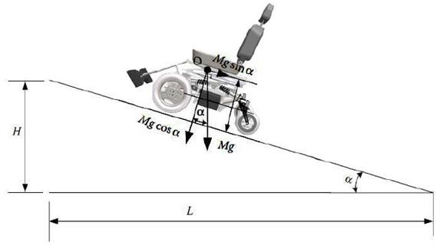
Calculation of Rolling Resistance
When climbing a vehicle due to road inclination, a resulting force from the weight of the vehicle appears as shown in Fig 1.
This force opposes the movement of the vehicle when it is on the hill.
Fig 1. Forces in road inclinations.

Slide 14
Calculation of Rolling Resistance
The ascent resistance F_{B} is calculated from the following formula:
F_{B}=F_{z}× Sin α--------------(6)
Where F_{z} is vertical force in newtons and α is the angle of the road inclination.
Tilt of the road is the ratio of the height H to the distance L (Fig 1) and expresses the height to be developed at a distance of 100 km:
Ι = Η/L = tan α ≈ sin α------------(7)
To find the angle α, in order to calculate the ascent resistance, the right formula is the following:
Α=tan⁻¹(i)

Slide 15
Calculation of Rolling Resistance
Thus, for a pavement slope of 10º the vehicle has an ascent resistance equals to:
F_{B}= 1147.77 × Sin10 = 199.31 N
F_{total}= F_{r} + F_{B} = 17.2+ 199.31 = 216.51 N
Where F_{total} is the total traction force which is the sum of ascent resistance F_{B} and the rolling resistance F_{r}
The torque needed on the wheel to overcome these resistors is calculated by the formula:
F_{t} = M_{k} × i_{tot}/r_{t} => M_{k} = F_{t} × r_{t} / i_{tot}
Where M_{k} is the torque on the wheel in Nm

Slide 16
Calculation of Rolling Resistance
The r_{t} the radius of the wheel and i_{tot} its gear transmission ratio from the motor to the wheel.
The motors have a diameter of 12inch (308mm) with a working voltage of 24V, 250Watt and a fixed gear transmission ratio of 23: 1.
The maximum torque that can be produced by the motor according to its operating diagram is 20Nm and is enough to overcome the climb and roll resistors.
F_{t} = M_{k} × i_{tot} / r_{t}
M_{k} = F_{t} × r_{t} / i_{tot}
= 22 × 0.154 / 23
= 1.5 Nm

Slide 17
Calculation of Rolling Resistance
According to standard values maximum speed of motor is 220 rpm and the maximum speed that the wheelchair can develop is 12Km/h.
This is calculated by the following formula:
N = V × 60/2 × π × r
V = n × 2 × π × r / 60
= 216.51 × 2 × π × 0.154/60
V = 3.50 m/s
V = 12.6 Km/h
Where V is the maximum speed that wheelchair can achieve in Km/h, n is motors speed in rpm and r is wheelchair’s wheel radius in m.

Slide 18
Calculation of Power
Work results when a force acts upon an object to cause a displacement (or a motion) or, in some instances, to hinder a motion.
Three variables are of importance in this definition
Force
Displacement
The extent to which the force causes or hinders the displacement
Each of these three variables find their way into the equation for work.
W=F×χ
Where W is the work in Joules, F is force in N and χ is the displacement in meters

Slide 19
Calculation of Power
Considering the above mathematical formulas and knowing the velocity it follows that:
P = F_{t}×V_{t}
Where P is the power in watts F_{t} is the traction force in N and V_{t} is the velocity in m/s.
Theoretically, the power given to the vehicle, when it moves at the maximum speed (3.54m/s) it can develop:
P = F_{t}×V_{t}
P= 17.2N × 3.50 m/s P= 60.2 Watt

Slide 20
Calculation of Power
The needed energy to drive the vehicle for one hour is calculated by the formula:
E= P×t
E = 0.0602KWh
Where E is the energy in KWh, P is power in watt and t is the time in hours.
According to the formula below, the vehicle needs 2.50Ah to move one hour at maximum speed.

Slide 21
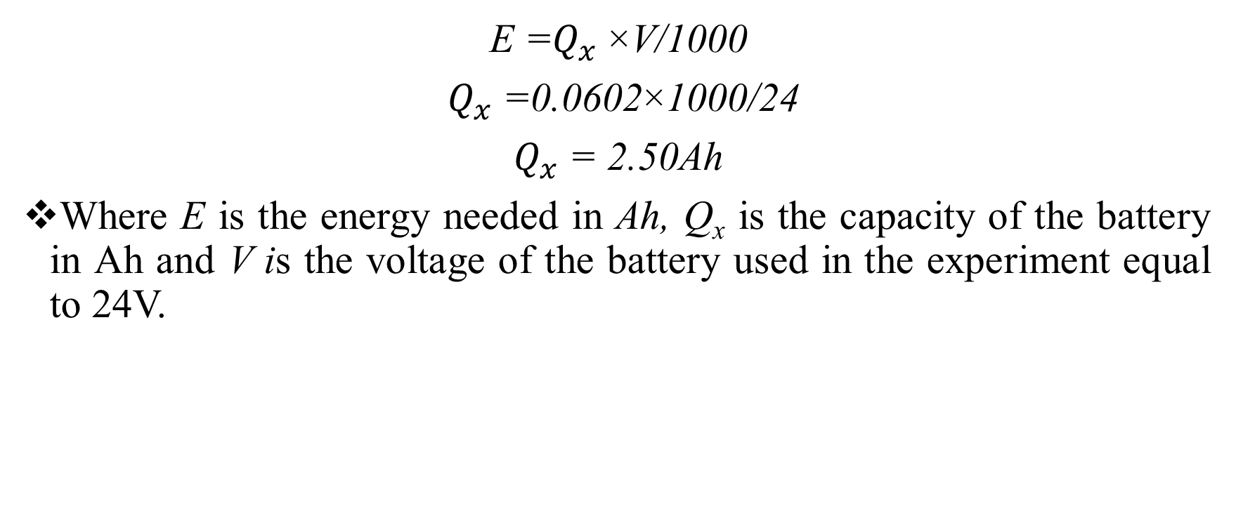
Calculation of Power
E =$Q_{x}$×V/1000
$Q_{x}$=0.0602×1000/24
$Q_{x}$= 2.50Ah
Where E is the energy needed in Ah, Q_{x} is the capacity of the battery in Ah and V is the voltage of the battery used in the experiment equal to 24V.

Slide 22
WORK DONE IN THIS SEMESTER
(S8)

Slide 23
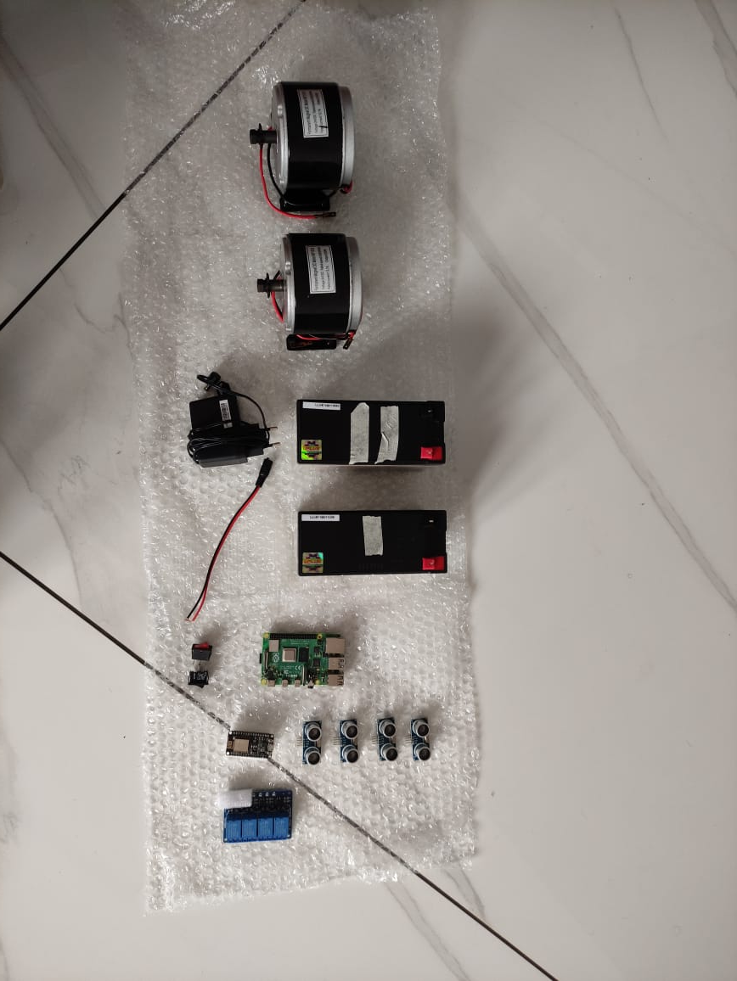
STATUS OF PROJECT WORK
Acquired and tested components of wheelchair.
Fig 2. Components

Slide 24
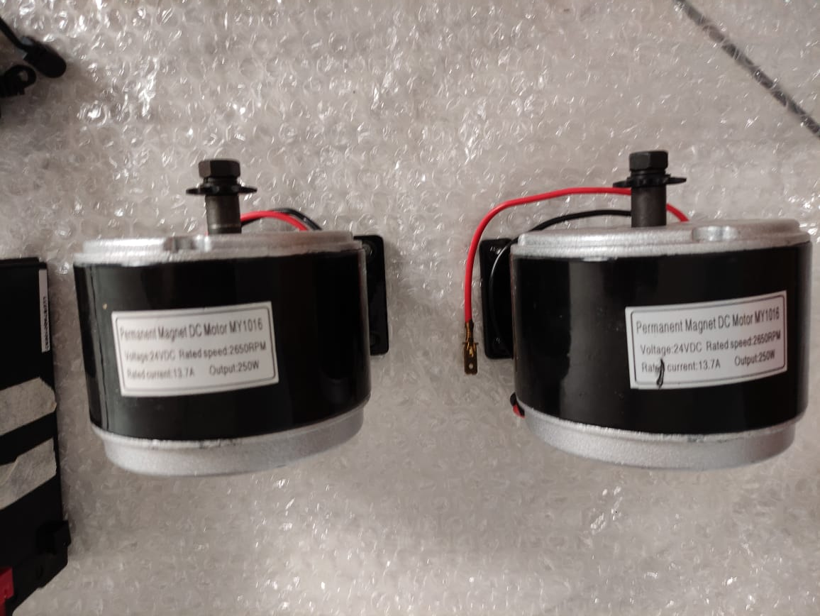
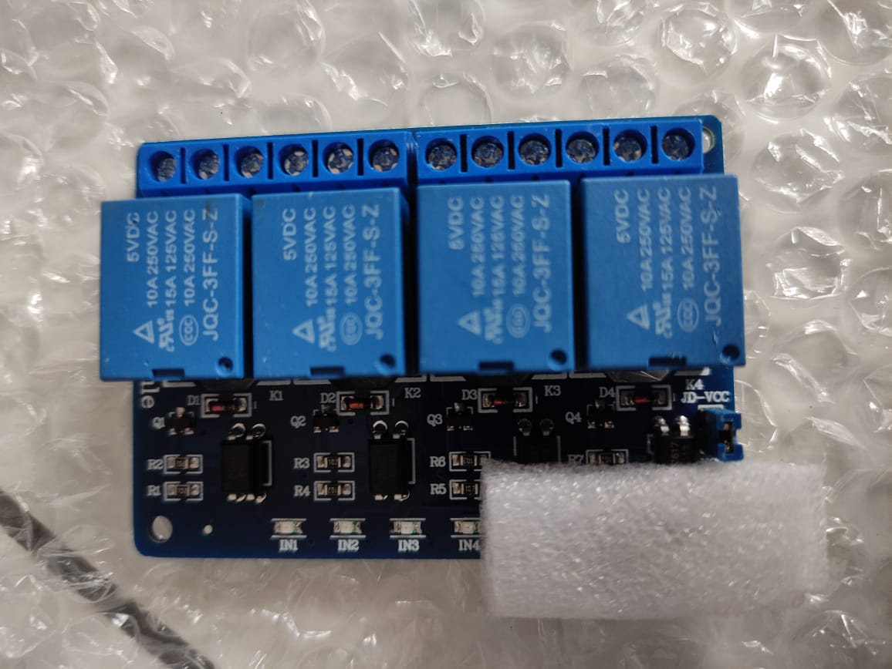
STATUS OF PROJECT WORK
Fig 3. 250W, 24V, 13.7A Motor
Fig 4. 4 Channel Relay(Peak 30V DC Supply)

Slide 25
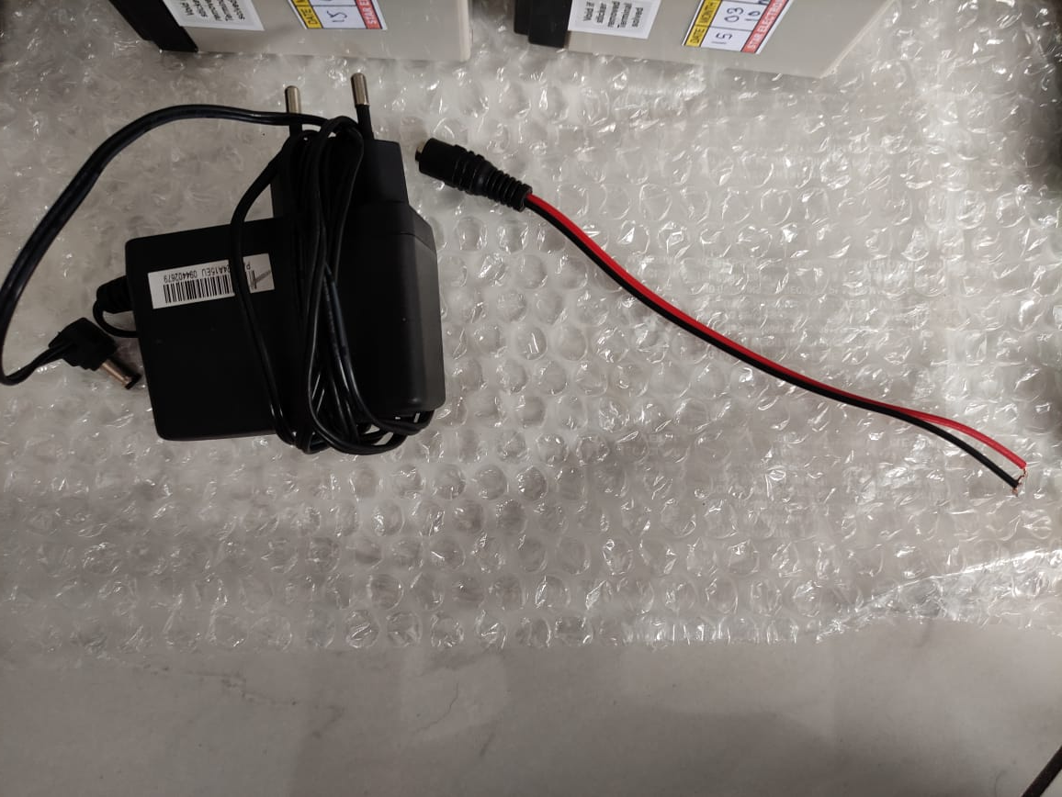
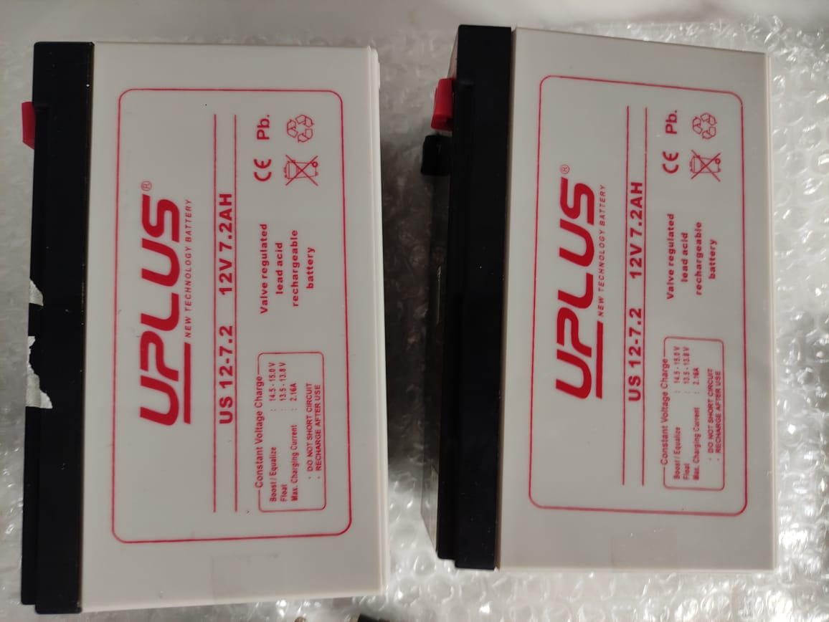
STATUS OF PROJECT WORK
Fig 5. 12V, 7.2Ah Battery
Fig 6. Battery Charger and Connector

Slide 26
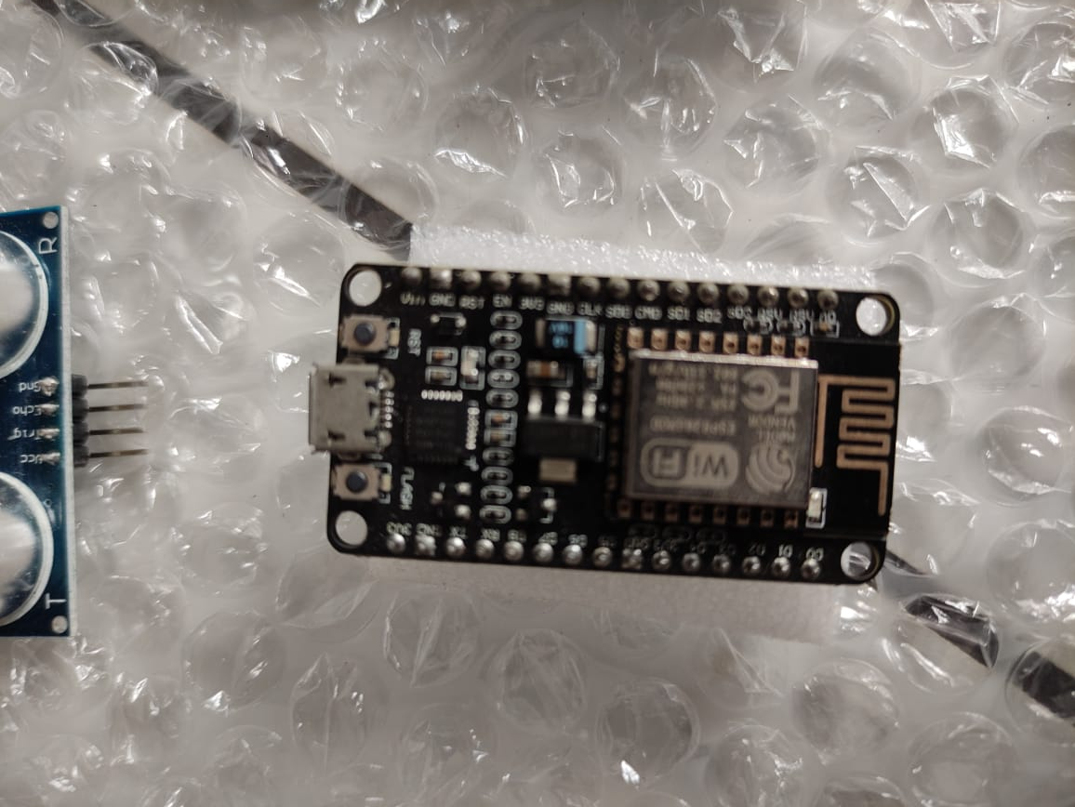
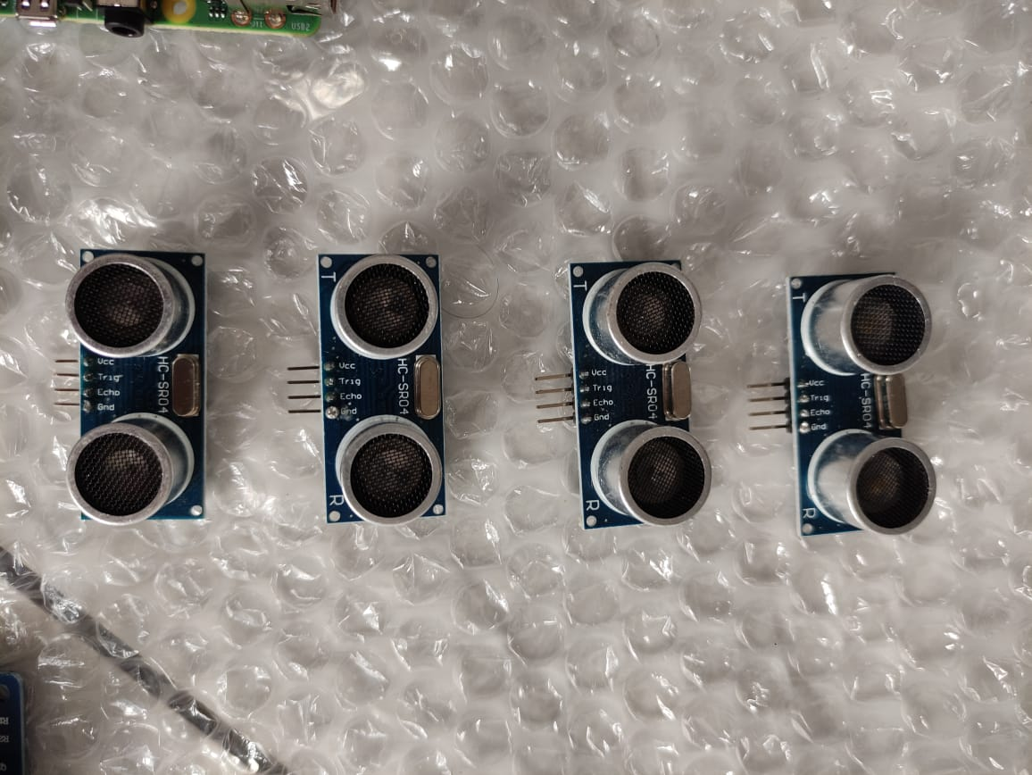
STATUS OF PROJECT WORK
Fig 7. Node MCU
Fig 8. Ultrasonic Sensors

Slide 27
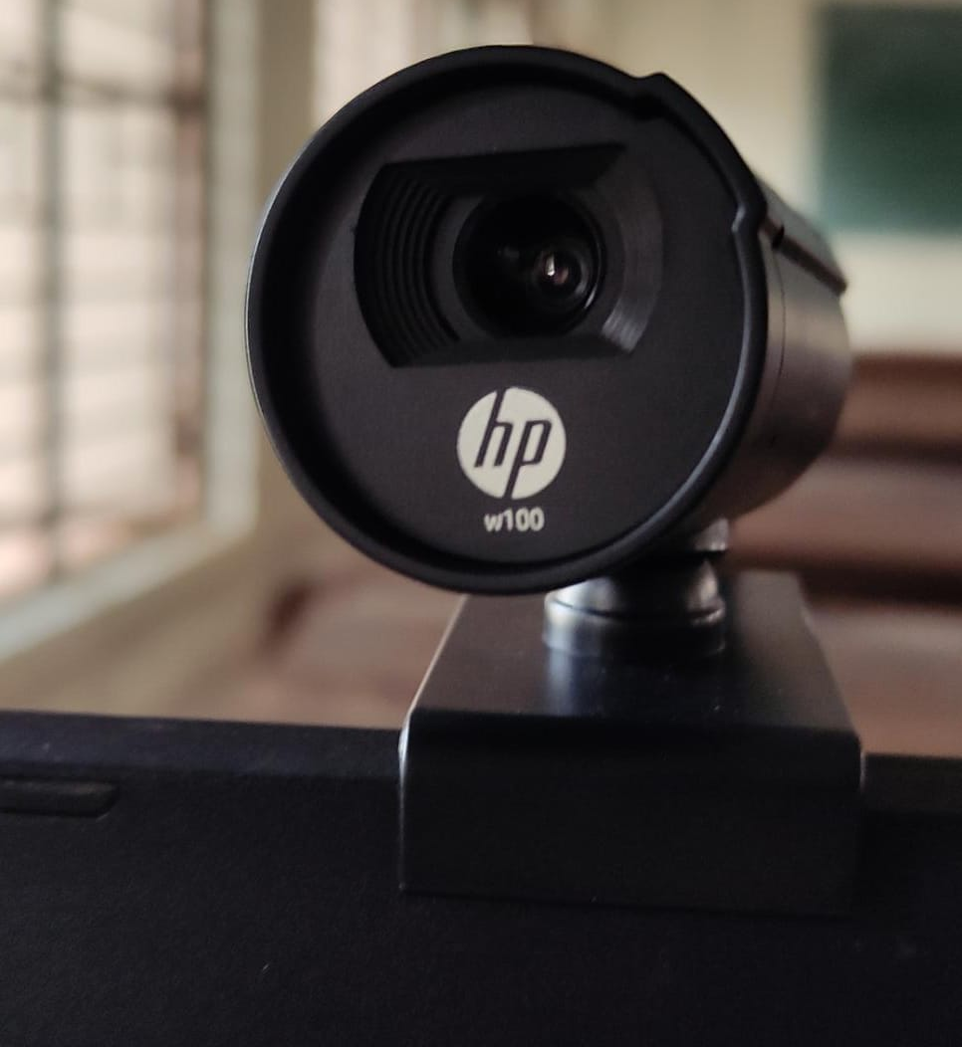
STATUS OF PROJECT WORK
Fig 9. Webcam

Slide 28
ESTIMATION OF COMPONENTS
SL No. | Component Name | Quantity | Price
1 | 250W, 24V, 13.7A Motor | 2 | 4600
2 | 4 Channel Relay(Peak 30V DC Supply) | 1 | 240
3 | 12V, 7.2Ah Battery | 4 | 3000
4 | 15V,2.2A Battery Charger | 1 | 250
5 | Node MCU | 1 | 500
6 | Ultrasonic Sensors | 4 | 400
7 | DC Wire Socket | 1 | 10
8 | Raspberry Pi 4 | 1 | 5100
9 | Webcam | 1 | 1500
10 | Wheelchair | 1 | 7000
11 | BTS7960B Bridge Motor Driver | 1 | 800

Slide 29
RASPBERRY PI 4 CONFIGURATION
Materials required:
Raspberry Pi 4
RJ45 LAN cable
32GB SD card and adapter
Software required:
Raspberry Pi OS
VNC Viewer and VNC Server
PuTTY Software

Slide 30

RASPBERRY PI INTERFACE
Fig 10. Raspbian OS Desktop Interface

Slide 31
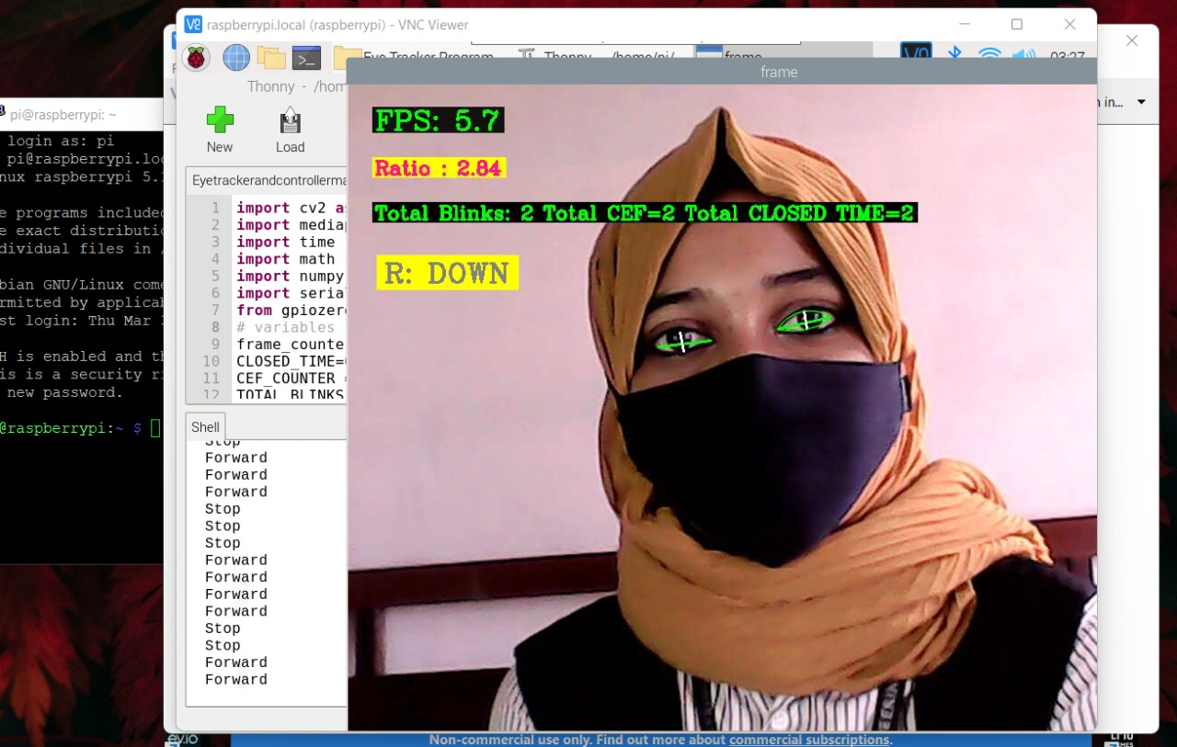
EYE TRACKING PROGRAM
Tested eye tracking program on Raspberry Pi 4
Fig 11. Eye tracking program on Raspberry Pi 4

Slide 32
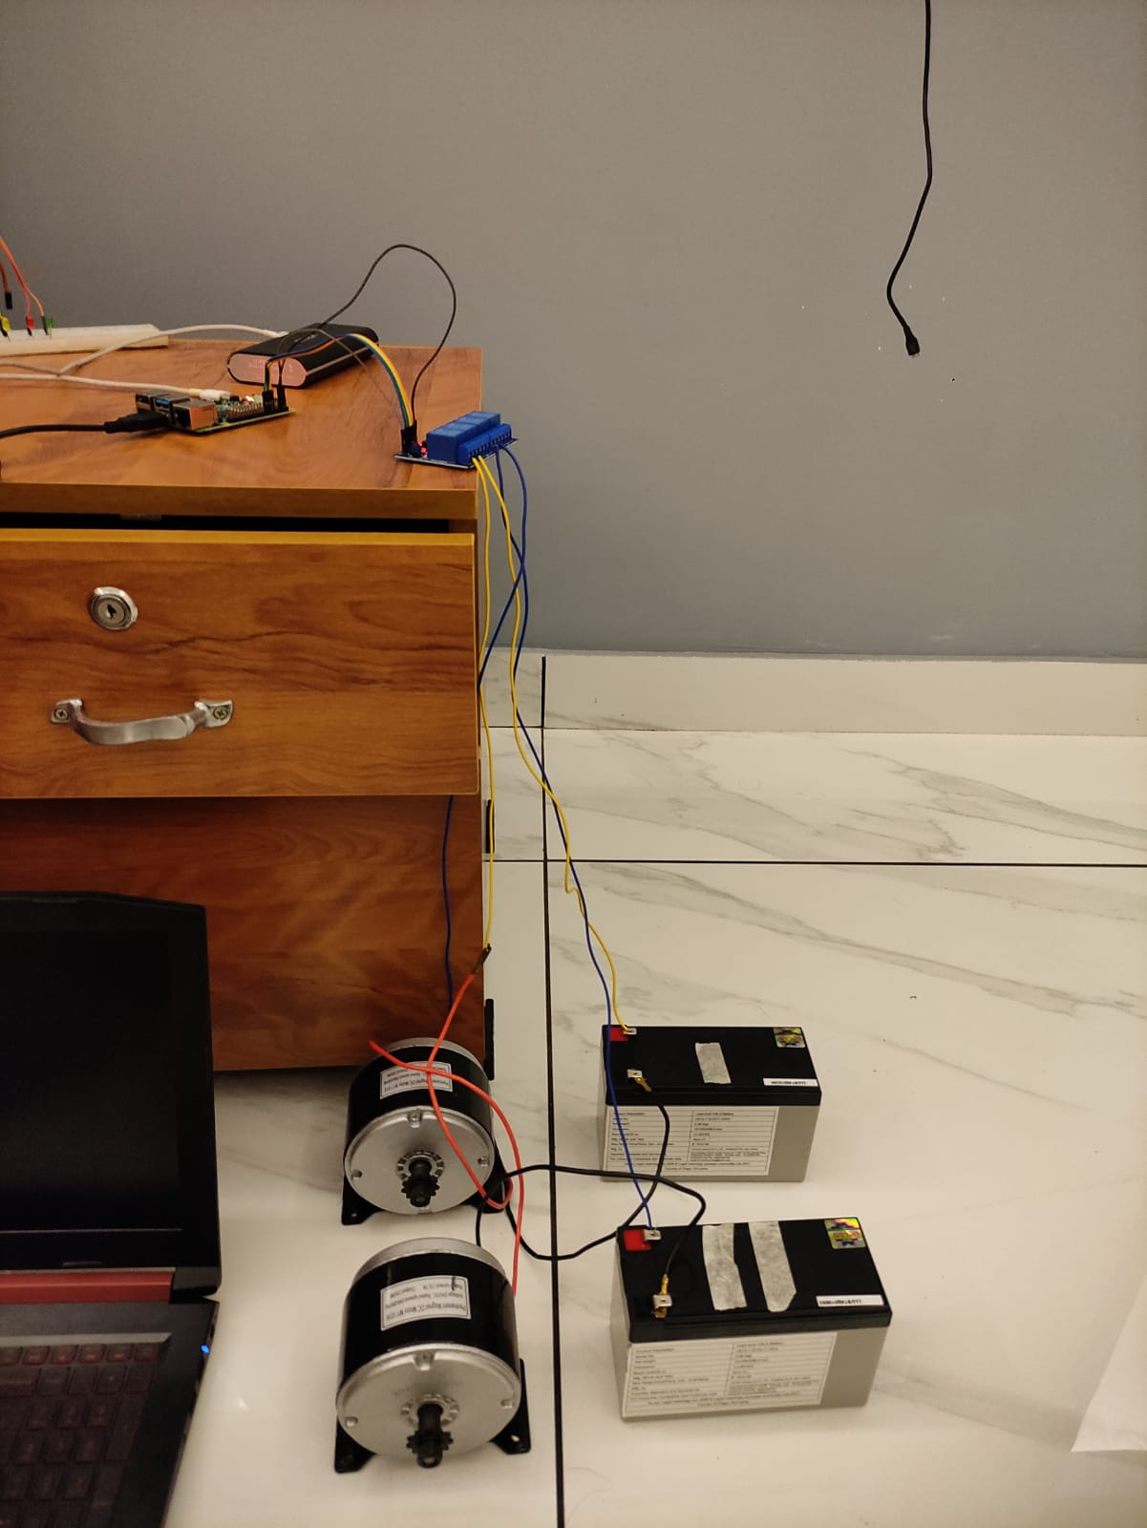
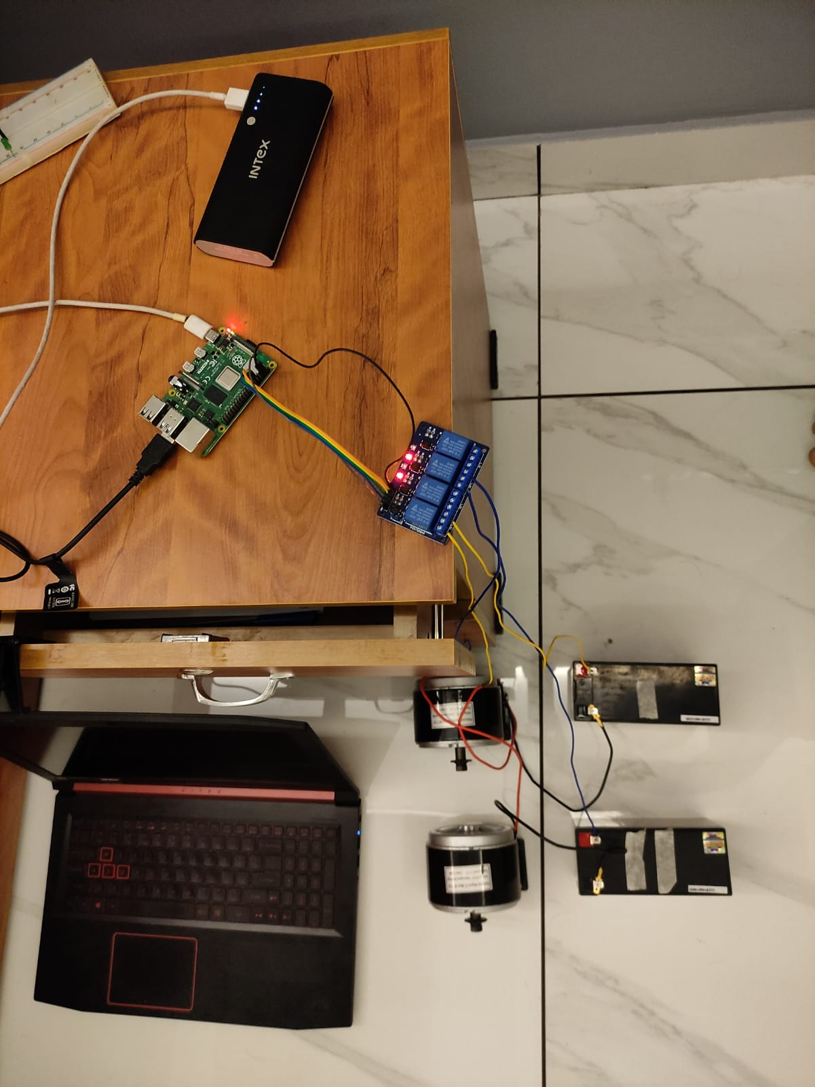
EYE TRACKING PROGRAM
Setup for Eye tracking program
Fig 12. Experimental Setup

Slide 33
WORK PLAN
Work | Oct 2021 | Nov 2021 | Dec 2021 | 1-2 weeks Jan 2022 | 3-5 weeks Jan 2022 | Feb 2022 | Mar 2022 | April 2022 | May 2022
Topic selection and preliminary works
Literature Survey
Program and train machine learning model for eye tracking.
Simulation of autonomous wheelchair.
Simulation of the circuit for home automation.

Slide 34
WORK PLAN
Work | Oct 2021 | Nov 2021 | Dec 2021 | 1-2 weeks Jan 2022 | 3-5 weeks Jan 2022 | Feb 2022 | Mar 2022 | April 2022 | May 2022
Interface the eye tracker, home automation and wheelchair together.
Purchase and test components
Hardware implementation of eye tracking glasses.
Hardware implementation of autonomous wheel chair.
Test and solve real time issues.

Slide 35
CONCLUSION
Literature review for the proposed model are done.
Raspberry Pi 4 is acquired and tested.
Eye tracking model is developed.
Simulation of autonomous wheel chair.
Components for the wheelchair are purchased and tested.
Raspberry Pi 4 is configured for our wheelchair.
Next phase is the assembling of eye controlled wheelchair.

Slide 36
REFERENCE
[1] Yi-Chen Lee, Ching-Min Lee, “Real-Time Smart Home Surveillance System of Based on Raspberry Pi”, IEEE, 2020
[2] Muhammad Azlan Alim, Samsul Setumin, Anis Diyana Rosli, Adi Izhar Che Ani, “Development of a Voice-controlled Intelligent Wheelchair System using Raspberry Pi”, IEEE, 2021
[3] V. Usha Rani, Dr. J Sridevi, P. Mohan Sai, “Web Controlled Raspberry Pi Robot Surveillance”, IEEE Conference, 2021

Slide 37
THANK YOU

Slide 38
LITERATURE REVIEW
[1]Tan Kian Hou, Yagasena and Chelladurai, “Arduino based voice controlled wheelchair”, IEEE, 2019
Smart motorized voice controlled wheelchair.
Voice command controls the movements of the wheelchair.
Microcontroller used is Arduino Uno.

Slide 39
LITERATURE REVIEW
[2]Ahmad F. Klaib, Nawaf . Alsrehin, Wasen Y. Melhem, Haneen Bashtawi, Aws A. Magableh, “Eye Tracking Algorithms, Techniques, Tools, and Applications with an Emphasis on Machine Learning and Internet of Things Technologies”, September 2020.
Machine learning and the Internet of Things are essential factors in the development of eye tracking applications.
This eye tracking techniques have more accurate detection results compared with traditional event-detection methods.

Slide 40
LITERATURE REVIEW
[3] Mohammed Hayyan Al Sibai, Sulastri Abdhul Manap, “A Study on Smart
Wheelchair Systems”, Research Gate Dec 2015
Presented different smart technologies for wheelchairs.
The human - machine interface and the navigation methods and devices, were the two key areas of concentration.

Slide 41

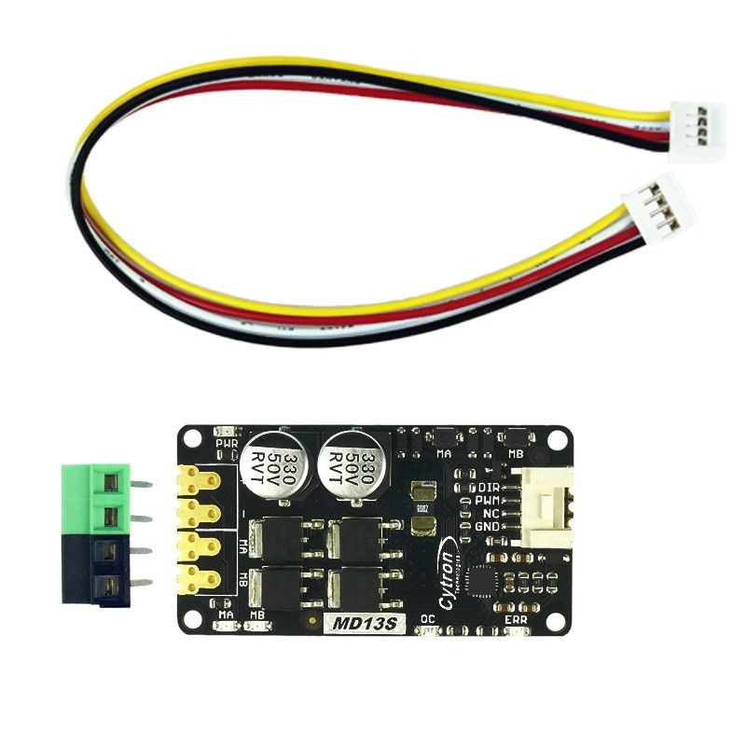
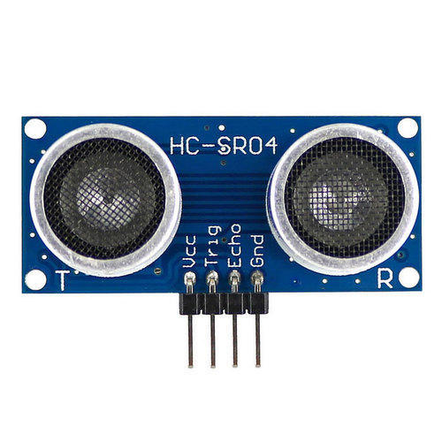
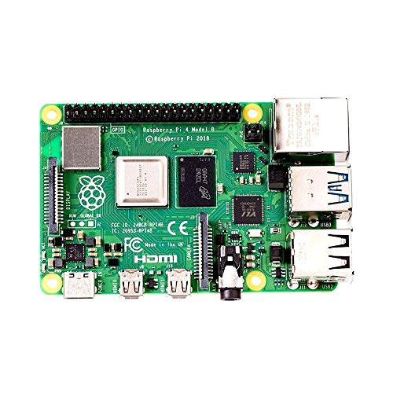
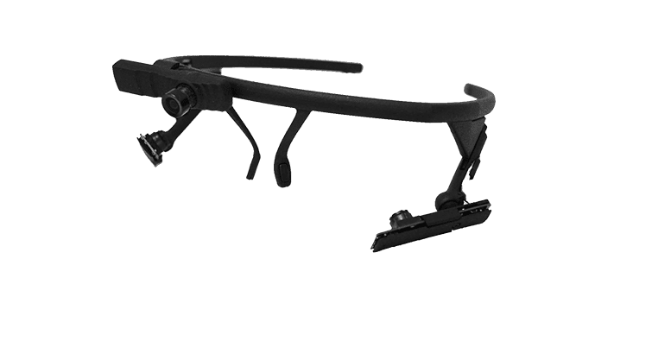
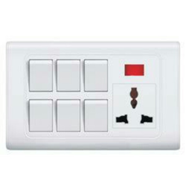
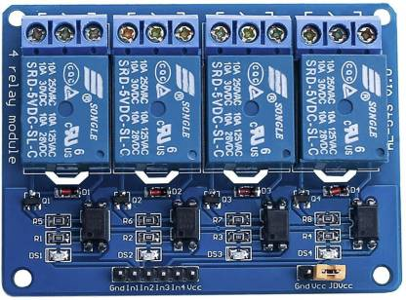
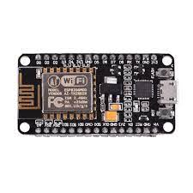
SCHEMATIC DIAGRAM
×8
LEFT MOTOR
DC MOTOR DRIVER
CAMERA MODULE
RIGHT MOTOR
RASPBERRY PI 4
RELAY CIRCUIT
NODE MCU
Fig 1. Block Diagram of Smart Wheelchair

Slide 42
SMART WHEELCHAIR
The whole project is divided into 3 parts
Eye tracking module using Raspberry Pi 4
Home automation system using Node MCU
Wheel Chair

Slide 43
SMART WHEELCHAIR
Eye tracking module using Raspberry Pi 4
Camera Module is used to capture eye movements.
The eye movement is tracked using the python eye tracking model using Raspberry Pi 4.
The position of the pupil is transferred to Node MCU.

Slide 44

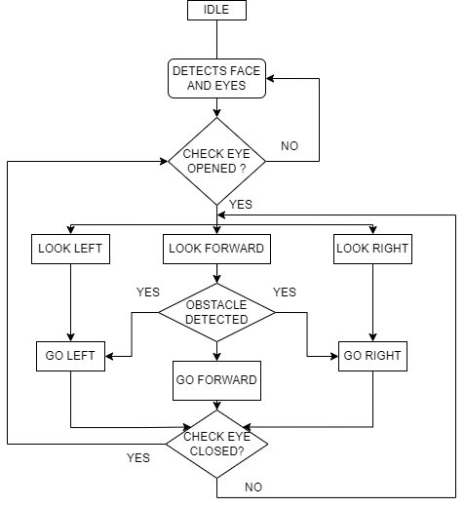
Fig 2. Flow Chart of Eye Tracking Program

Slide 45
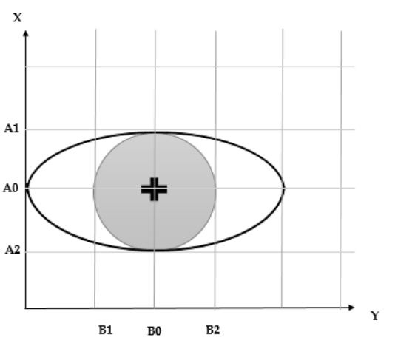
SMART WHEELCHAIR
Fig 3. Detection of Pupil in Tracking Program

Slide 46
SMART WHEELCHAIR
Wheel Chair
Wheel chair is also controlled on the basics of the control signal received from Raspberry Pi 4.
The wheel chair have low speed for safety.
8 ultra sonic sensors are connected in 4 directions of the wheelchair for obstacle and pit detection.
Incase an obstacle is identified the wheel chair stops and trajectory can be corrected.

Slide 47
SMART WHEELCHAIR
Home automation system using Node MCU
From the position received from Raspberry Pi 4, appropriate decision is taken by the Node MCU.
Control by Node MCU include the switches of light and fan.

Slide 48
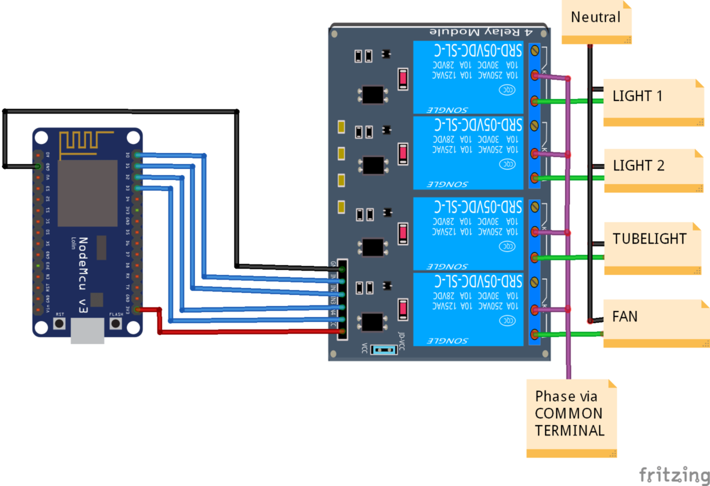
SMART WHEELCHAIR
Fig 4. Home Automation System Using Node MCU and Bluetooth Module

Slide 49
WORK DONE IN PREVIOUS SEMESTER
(S7)

Slide 50
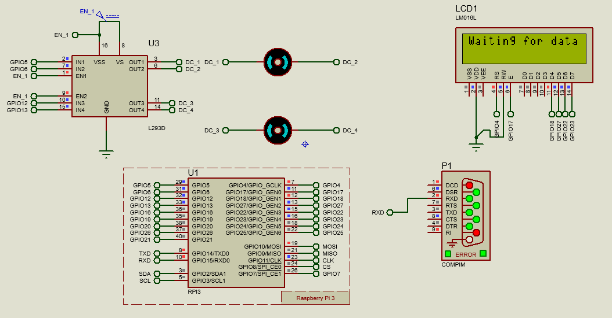
STATUS OF PROJECT WORK
Simulation of Smart Wheel Chair
Fig 5. Simulation Model of Smart Wheelchair

Slide 51
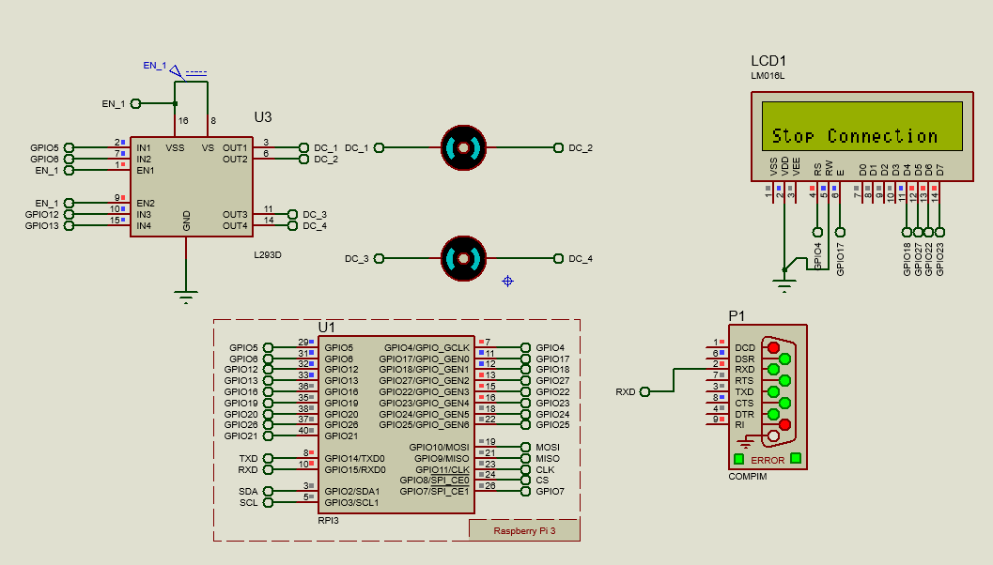
STATUS OF PROJECT WORK
Simulation of Smart Wheel Chair
Fig 6. Simulation Model of Smart Wheelchair

Slide 52
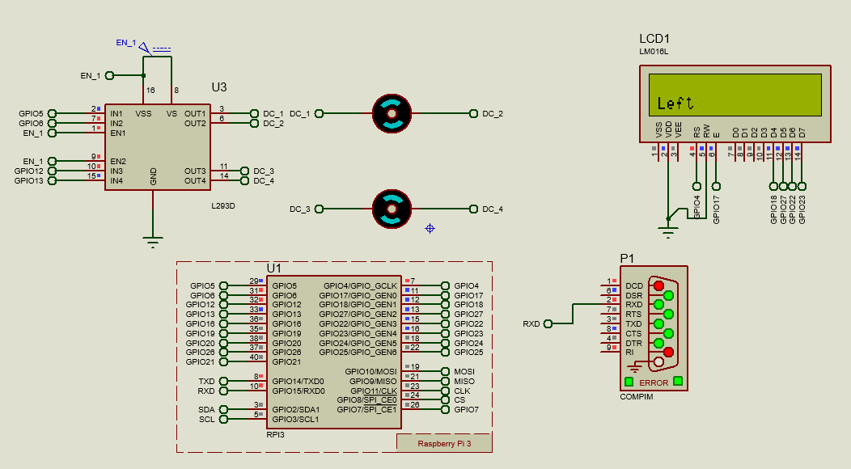
STATUS OF PROJECT WORK
Simulation of Smart Wheel Chair
Fig 7. Simulation Model of Smart Wheelchair

Slide 53
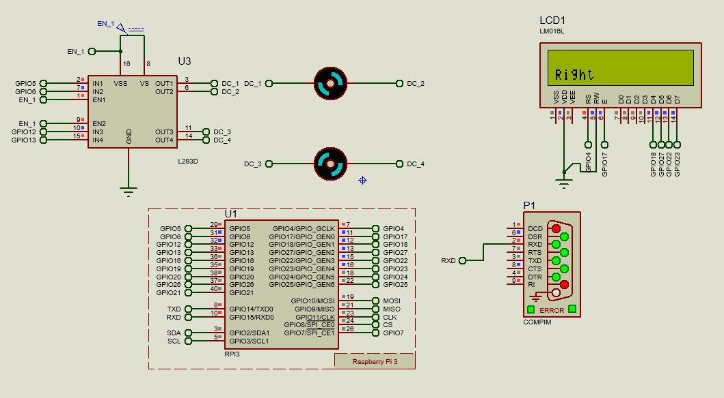
STATUS OF PROJECT WORK
Simulation of Smart Wheel Chair
Fig 8. Simulation Model of Smart Wheelchair

Slide 54
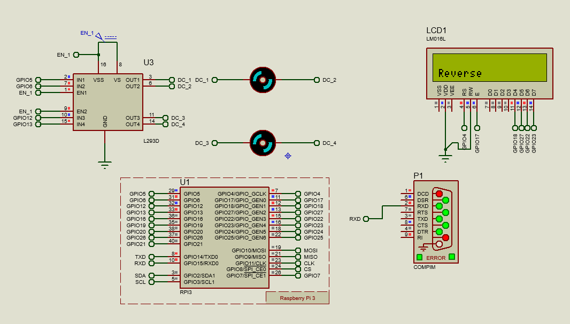
STATUS OF PROJECT WORK
Simulation of Smart Wheel Chair
Fig 9. Simulation Model of Smart Wheelchair

Slide 55
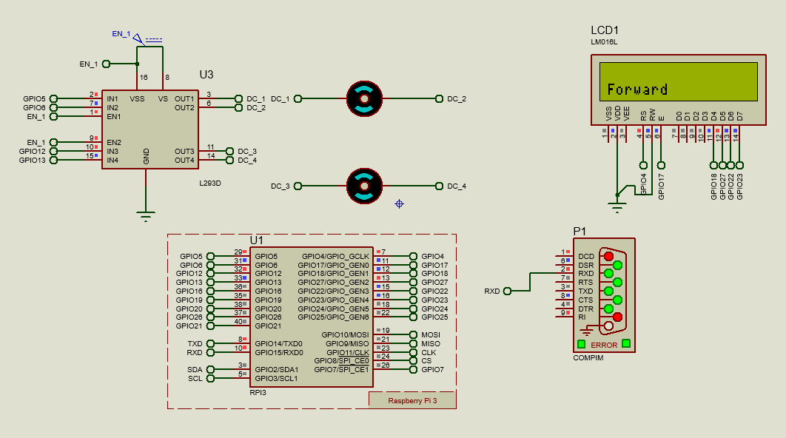
STATUS OF PROJECT WORK
Simulation of Smart Wheel Chair
Fig 10. Simulation Model of Smart Wheelchair

Slide 56
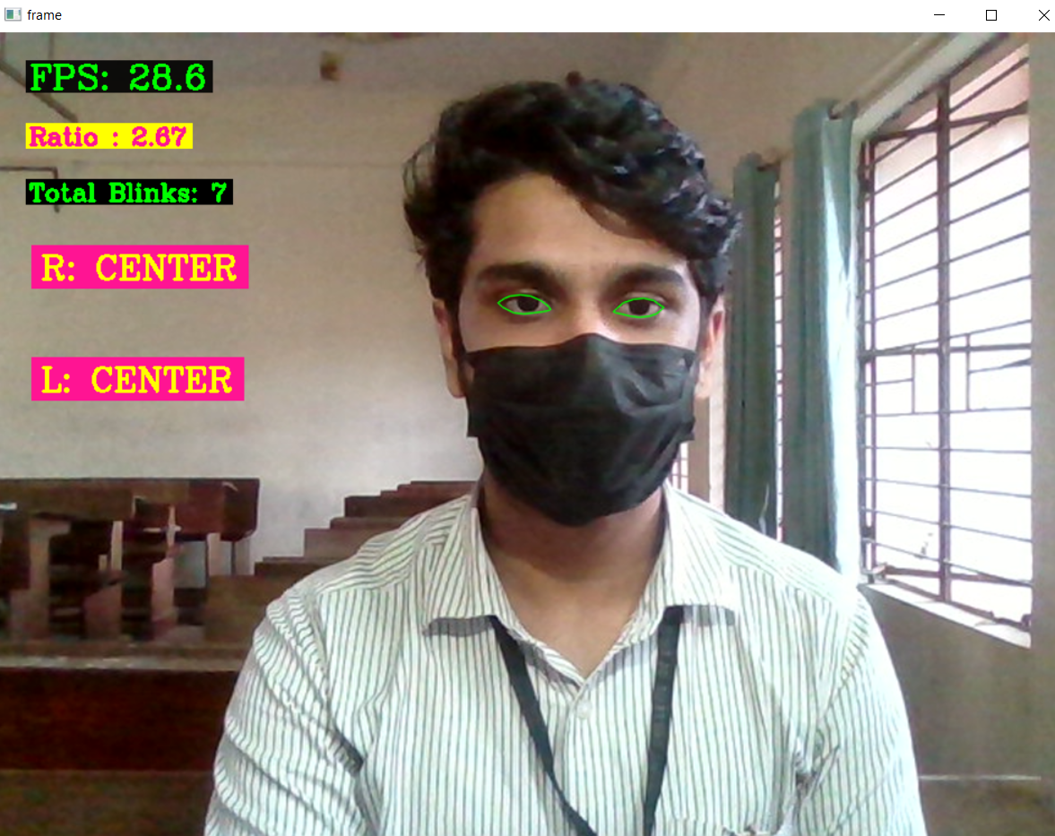
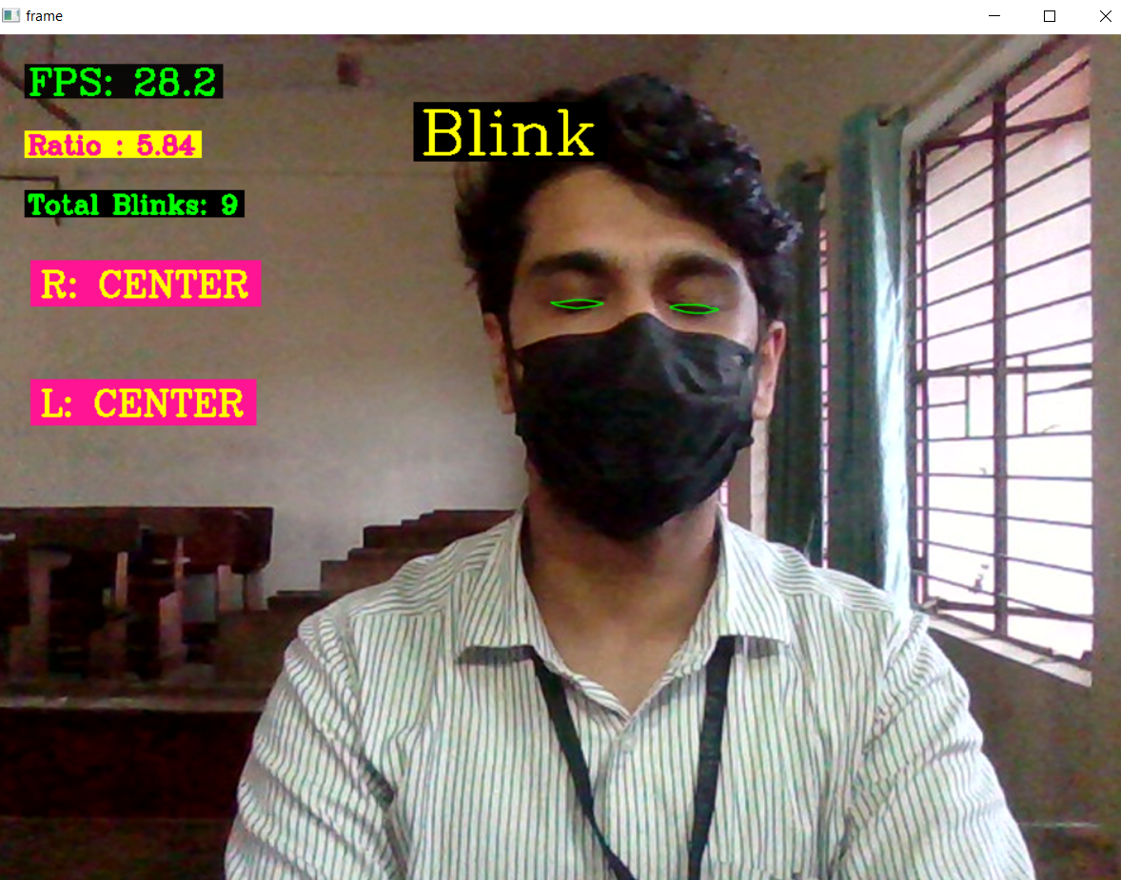
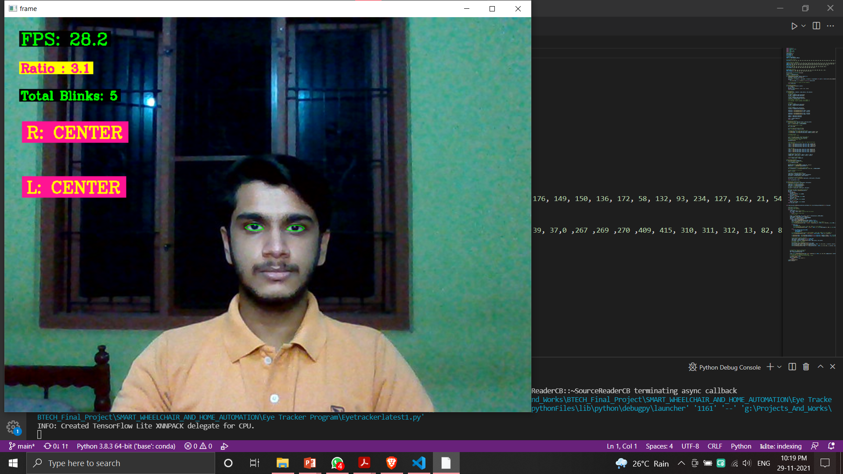
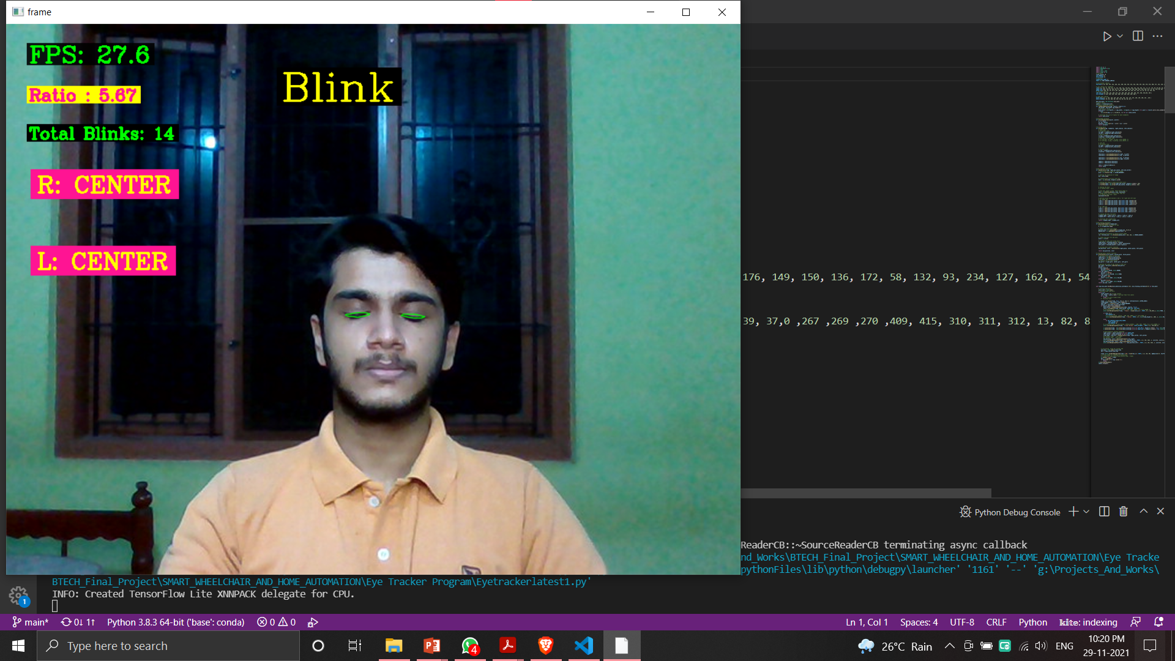
STATUS OF PROJECT WORK
Eye tracking program is developed and its results are shown below.
Fig 11.Straight
Fig 12. Closed

Slide 57
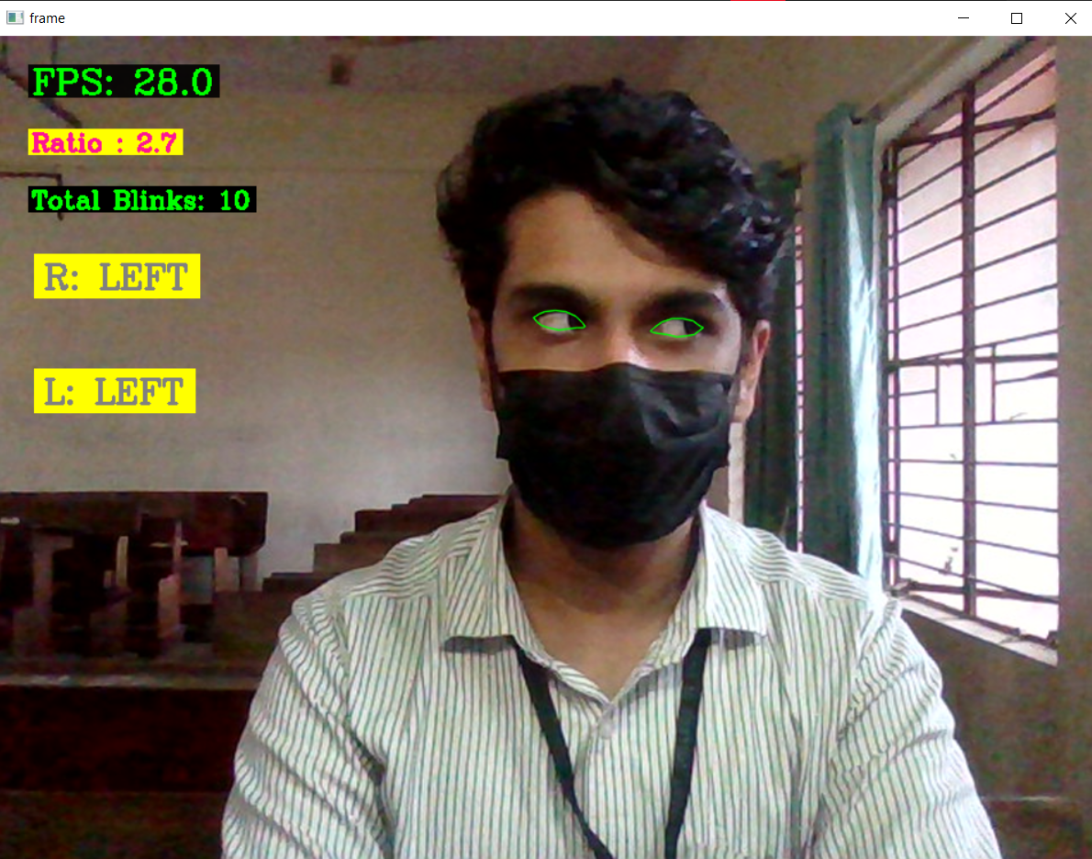
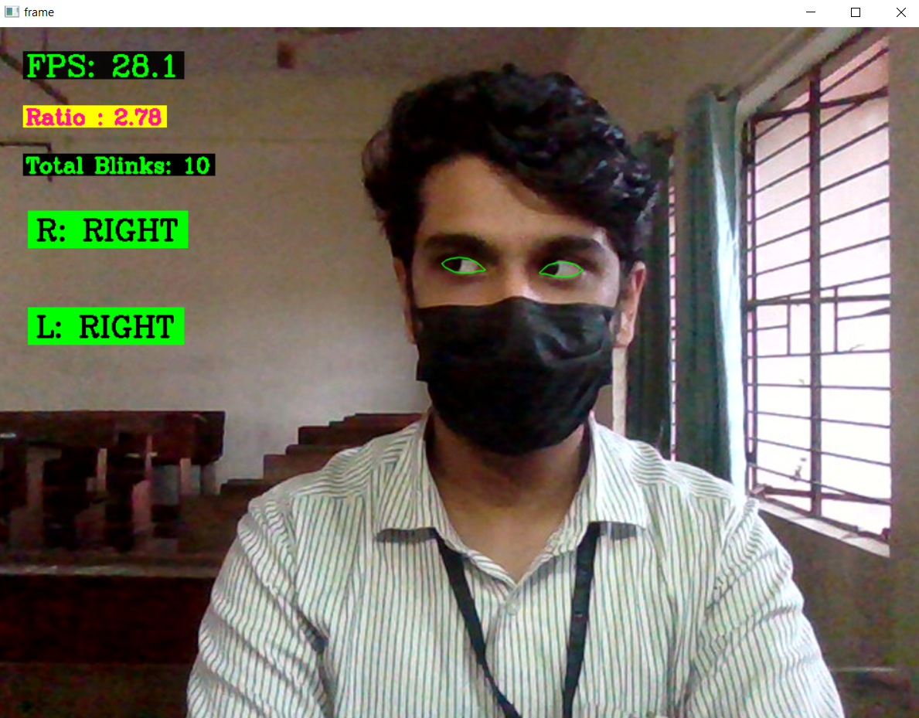


STATUS OF PROJECT WORK
Eye tracking program is developed and its results are shown below.
Fig 13. Left
Fig 14. Right

Slide 58
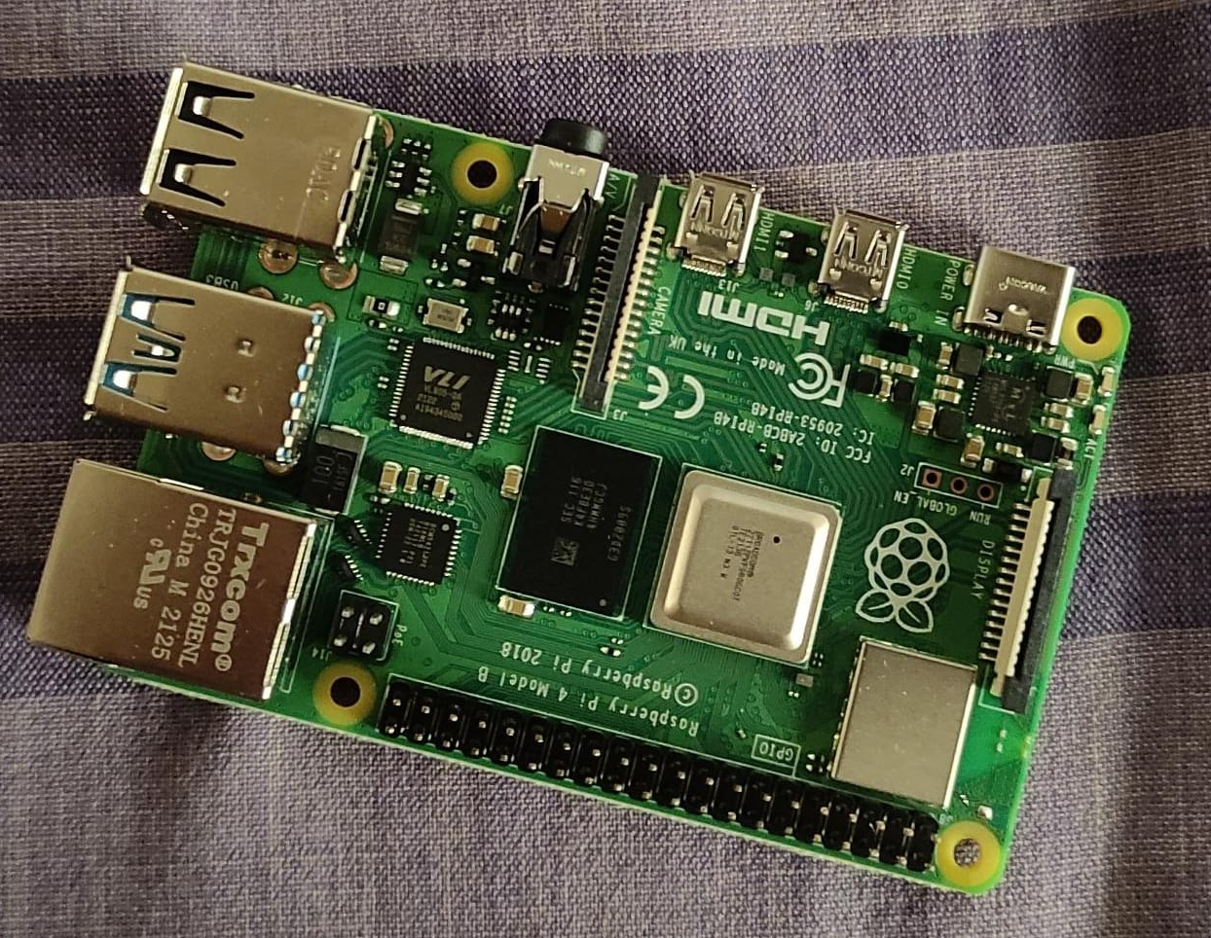
STATUS OF PROJECT WORK
Acquired and tested Raspberry Pi 4, 4GB model.
Fig 15. Raspberry Pi 4

